Slide 1

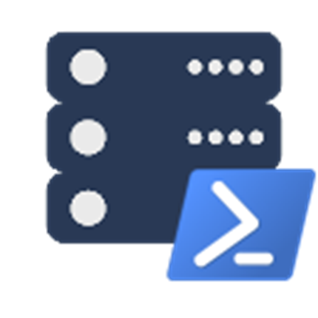

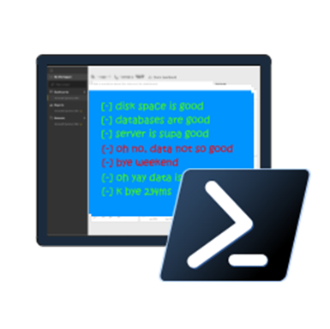
PowerShell & SQL Server with Drew and Rob

Slide 2





Rob Sewell
Contact Rob
Sewells Consulting Limited
PowerShell Automator, PowerShell Trainer, Database DevOps
@sqldbawithbeard
robsewellsqldba
MVP, Speaker and Organizer
Half a Best Speaker!!, PowerShell and SQL user groups, national and international events
sqldbawithAbeard.com
dbatools dbareports dbachecks
Loves Pester. Always available for help via the usual social media channels
mrrobsewell@outlook.com
RobSewell.info
Notes:
This is Rob He runs his own company providing PowerShell magic, PowerShell Training and Database DevOps consultancy he’s a speaker and organiser for SQL South West, SQL Saturday Exeter, PSDayUK, PSConf.eu, PSConfasia and conference volunteer at SQL Bits

Slide 3
Rob Sewell
Drew Ferguellieielllliei
Beinng Awesome
Drew is Awesome
@PittFurg
pittfurg
Speaker and Organizer
Being Awesome
port1433.com
Awesome Things
Just Awesome
Notes:
This is Rob He runs his own company providing PowerShell magic, PowerShell Training and Database DevOps consultancy he’s a speaker and organiser for SQL South West, SQL Saturday Exeter, PSDayUK, PSConf.eu, PSConfasia and conference volunteer at SQL Bits

Slide 4
Agenda, before lunch
What we are aiming to solve
Orientation
VS Code
PowerShell
dbatools
Pester

Slide 5
Agenda, after lunch
Dbatools
Agent Jobs
Dbachecks
Q & A

Slide 6
Problems we’re aiming to solve
Reduce Hesitations about PowerShell
Increase Confidence
Whether it’s about security concerns or feeling like PowerShell is too different or hard
You’ve got a whole community that’s excited to help!
Encourage Community Contributions
Induce Excitement about Testing
Join Microsoft and the community in the global open source movement
It may be a challenge, but we’re up for it!

Slide 7

PowerShell Orientation

Slide 8






PowerShell Code Editors
Notepad
Notepad ++
PowerShell ISE
Sapien PowerShell Studio
Visual Studio
Visual Studio Code

Slide 9
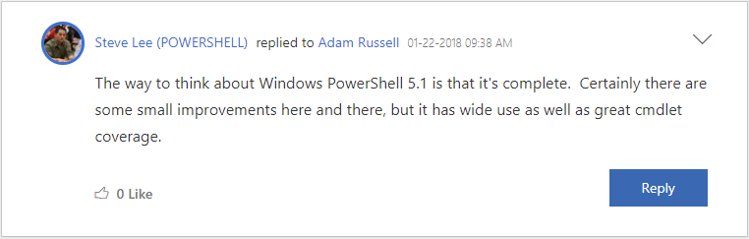
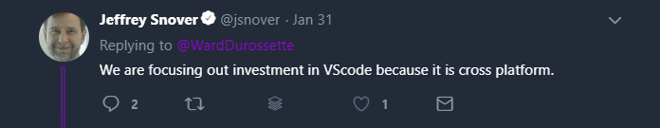
Why Not ISE?

Slide 10
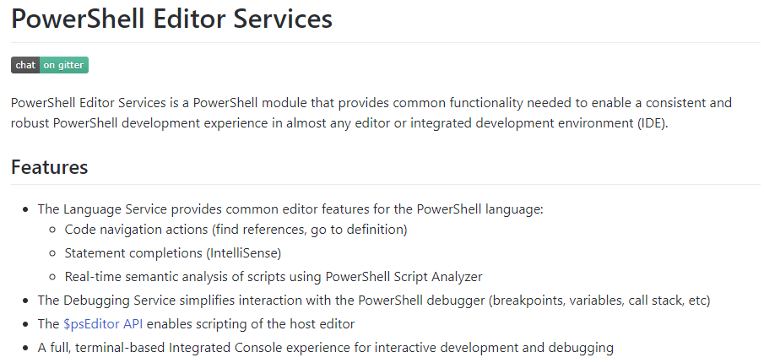
PowerShell Editor Services
powershell.github.io/PowerShellEditorServices/

Slide 11
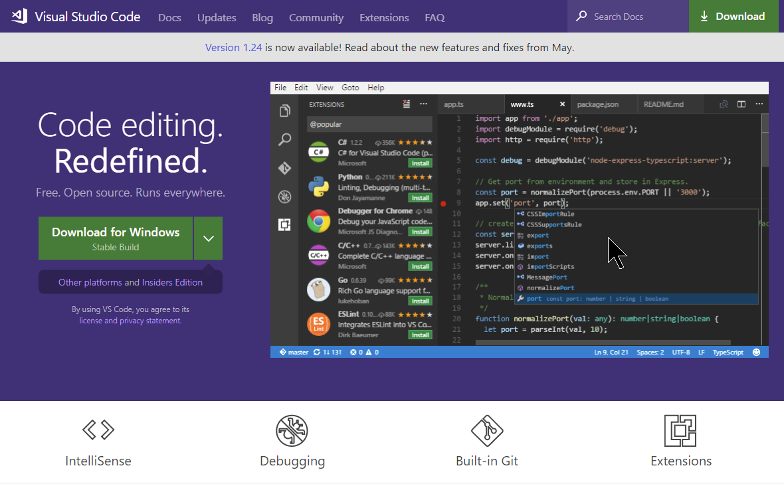
code.visualstudio.com

Slide 12
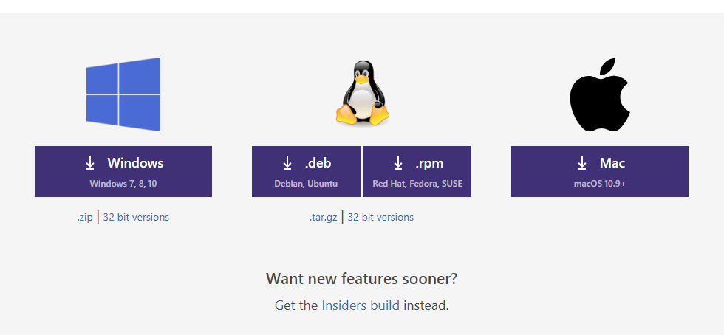
Multi-Platform

Slide 13
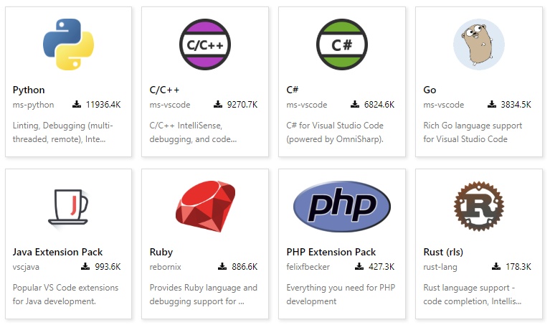
Multi-Language

Slide 14
Multi-Language
Batch
C#
C++
Clojure
Coffee Script
CSS
Dockerfile
F#
Go
Groovy
Jade
Java
JavaScript
JSON
HandleBars
HTML
Ini
Less
Lua
Makefile
Markdown
Objective-C
Perl
PHP
PowerShell
Python
R
Razor
Ruby
Rust
Sass
SQL
Swift
TypeScript
Visual Basic
XML

Slide 15
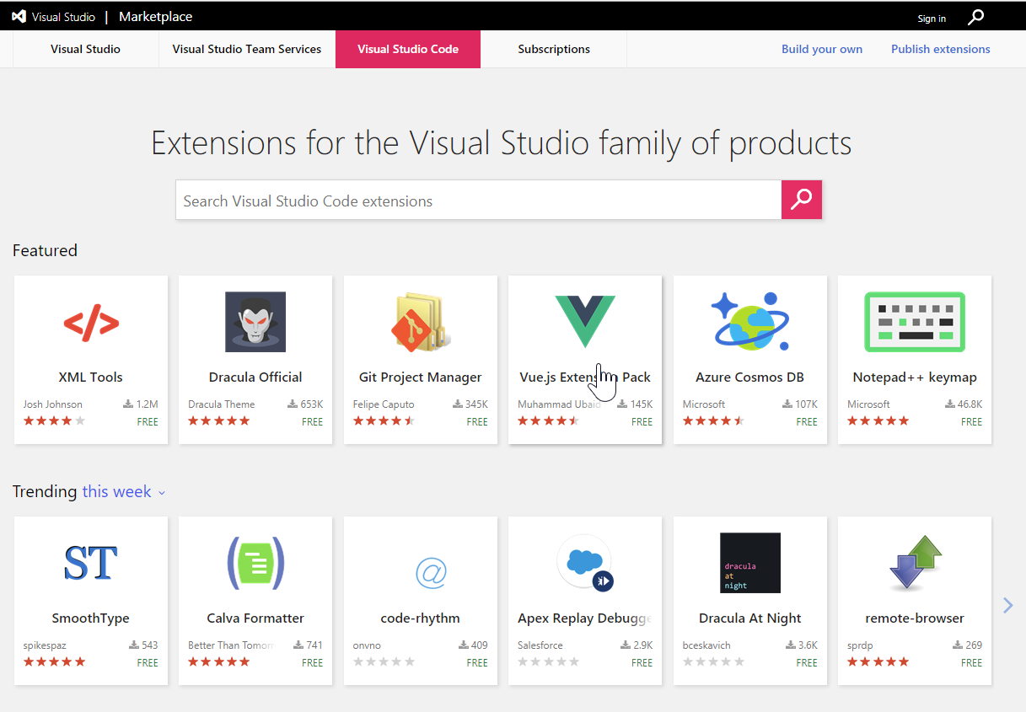
marketplace.visualstudio.com/vscode

Slide 16
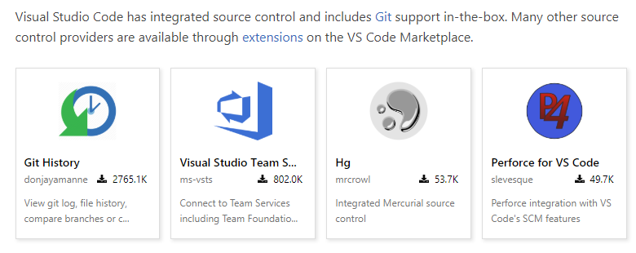
Multiple Source Control

Slide 17
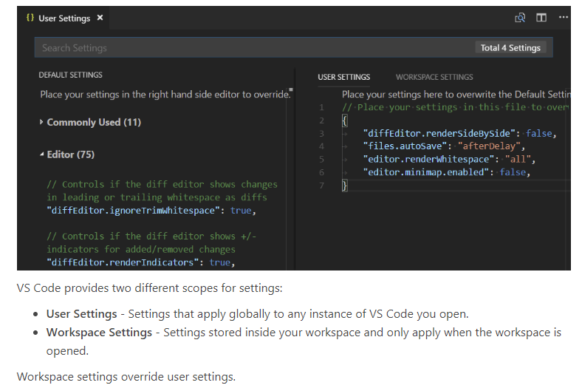
Configurable

Slide 18
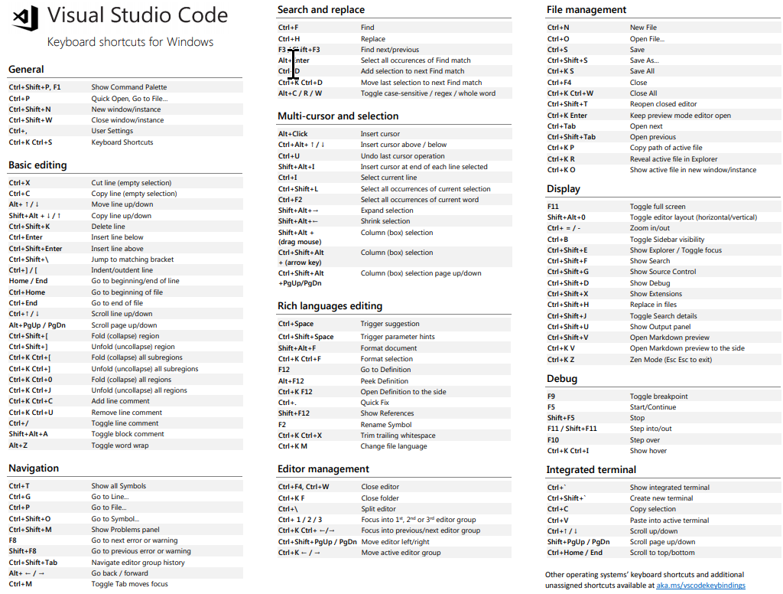
Keyboard Shortcuts
code.visualstudio.com/docs/getstarted/keybindings

Slide 19
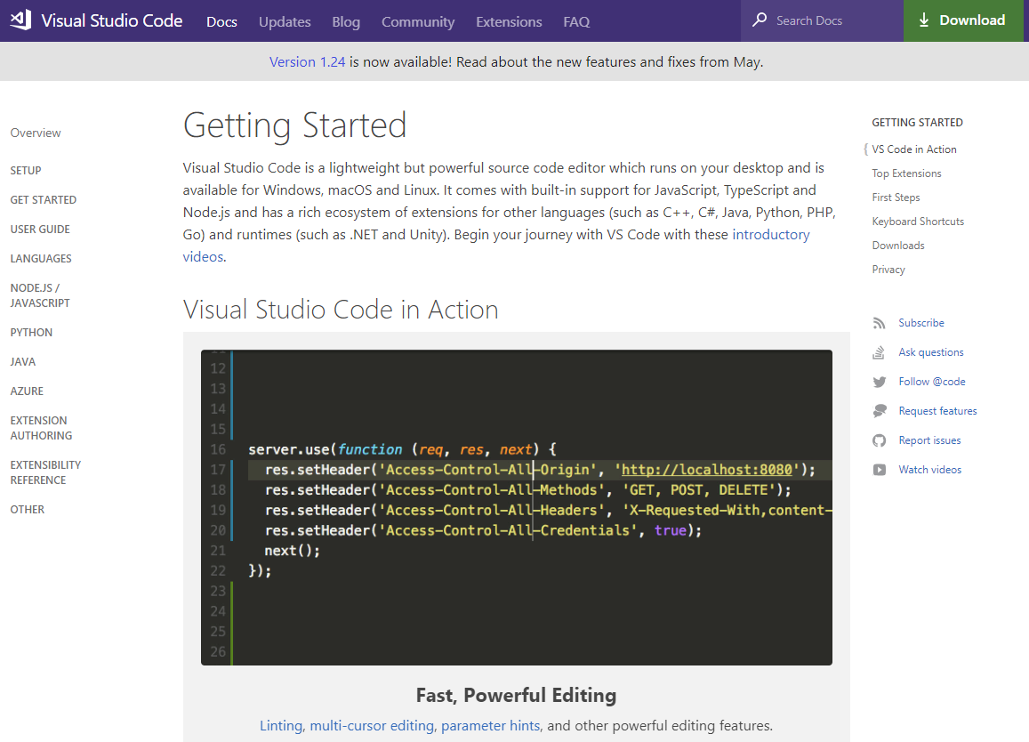
Get-Help
code.visualstudio.com/docs/

Slide 20

Hey Beardy – Enough Talk!
Time For A DEMO

Slide 21

PowerShell Remoting & Security
Notes:
https://www.youtube.com/watch?v=BIwe571zcWY
The Little JPEG that Could Hack Your Organization w Marcus Murray

Slide 22
PowerShell Remoting
Windows PowerShell supports remote computing by using various technologies, including WMI, SQL WMI, RPC, SSH & and WS-Management
Some commands require no remote configuration, including
Restart-Computer
Test-Connection
Get-HotFix
Get-Process
Get-Service
Get-WinEvent
“Remoting” refers to commands that use WS-Management
Notes:
https://docs.microsoft.com/en-us/powershell/scripting/core-powershell/running-remote-commands?view=powershell-5.1

Slide 23
PowerShell Remoting (WS-Management)
Microsoft’s recommended way to manage Windows
By default, only allows connections from members of the Administrators group
Single port 5985 or 5986
Uses the Web Services for Management (WS-Management) protocol
Regardless of the transport protocol used (HTTP or HTTPS), PowerShell Remoting always encrypts all communication after initial authentication with a per-session AES-256 symmetric key
Initial authentication is NTLM, Kerberos and Certificates so no credentials are ever exposed
Notes:
Centralized admin
https://docs.microsoft.com/en-us/powershell/scripting/setup/winrmsecurity?view=powershell-5.1
https://blogs.technet.microsoft.com/ashleymcglone/2016/06/29/whos-afraid-of-powershell-security
https://github.com/psconfeu/2017/tree/master/David%20das%20Neves/PSConfEU17_Security_Preconf
https://blogs.msdn.microsoft.com/daviddasneves/2017/05/25/powershell-security-at-enterprise-customers/
https://vimeo.com/17649459

Slide 24
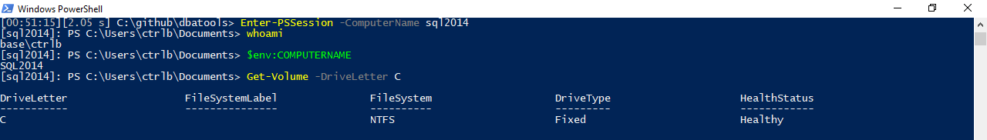
PowerShell Remoting
Notes:
Windows PowerShell supports remote computing by using various technologies, including WMI, RPC, and WS-Management.

Slide 25
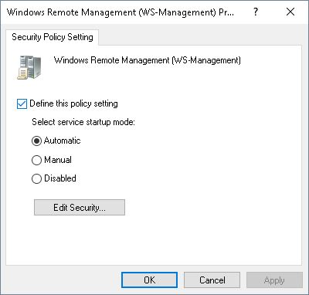
PowerShell Remoting
Enable-PSRemoting
winrm quickconfig
Via Group Policy Objects
Notes:
https://4sysops.com/archives/enable-powershell-remoting/

Slide 26
Remoting Setup
sqlps.io/remoting
Notes:
See a dude own a DC thru jpg, sql server and a stolen token

Slide 27
PowerShell Security

Slide 28
PowerShell Security
“Secure by Design”

Slide 29
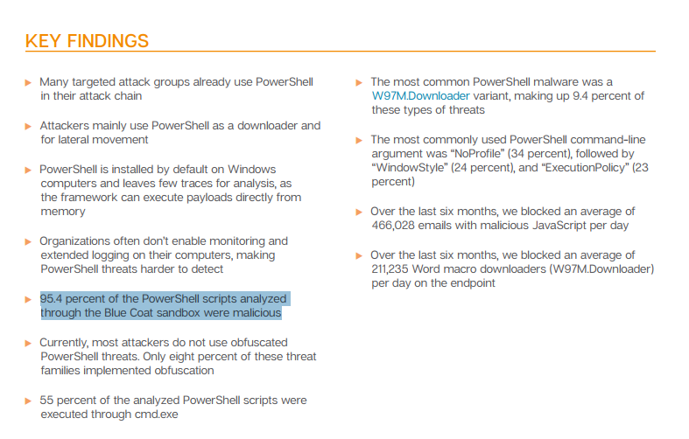
FUD in the Media
🙄
Notes:
https://www.symantec.com/connect/blogs/powershell-threats-surge-954-percent-analyzed-scripts-were-malicious

Slide 30
FUD in the Media
“AV, they love to talk about ransomeware attacks that use PowerShell, and the reason they do this is because they literally can’t keep up with the plain old stuff like exes. But they also do this because we as a community encourage it. We blog it, we tweet about it, we talk about it. And the next thing you hear is that there’s a PowerShell problem. They don’t seem to ask how to solve their C++ problem or their darn x64 problem.” ~ Lee Holmes, DerbyCon 2016 Keynote
Notes:
https://www.youtube.com/watch?v=BMreZZ1cgFI
https://docs.microsoft.com/en-us/powershell/scripting/setup/winrmsecurity?view=powershell-5.1
https://blogs.technet.microsoft.com/ashleymcglone/2016/06/29/whos-afraid-of-powershell-security
https://github.com/psconfeu/2017/tree/master/David%20das%20Neves/PSConfEU17_Security_Preconf
https://blogs.msdn.microsoft.com/daviddasneves/2017/05/25/powershell-security-at-enterprise-customers/

Slide 31
Context
”When security researchers leverage PowerShell, it is always in a post-compromise context. They have compromised a machine through some other avenue (phishing, SQL injection, etc.), and ultimately have the choice of any number of tools on the system. They were able to accomplish their goals before PowerShell, and will be able to accomplish their goals without PowerShell.”
~ Lee Holmes, Principal Security Architect
Notes:
https://blogs.msdn.microsoft.com/powershell/2016/09/27/powershell-security-at-derbycon/

Slide 32
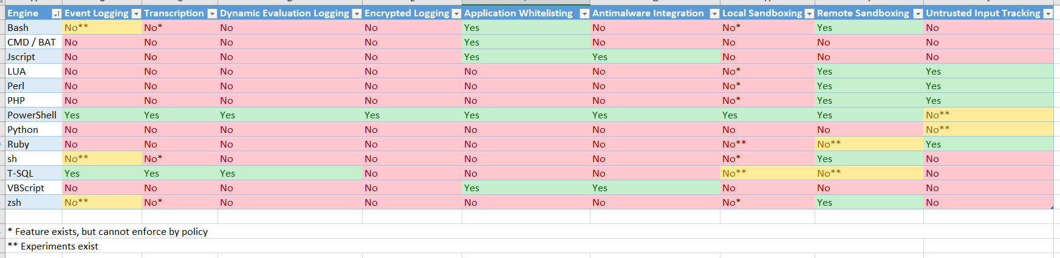
Logging
Notes:
Assume breach
Rob’s slide
https://blogs.msdn.microsoft.com/powershell/2017/04/10/a-comparison-of-shell-and-scripting-language-security/
Event Logging – The engine logs audit events of important operational events.
Transcription – The engine logs application inputs and outputs.
Dynamic Evaluation Logging – The engine logs the content of all content evaluation, including those generated or composed at runtime.
Application Whitelisting – The engine allows enforcement of code integrity / application whitelisting policies, including user-authored documents / scripts.
Antimalware Integration – The engine actively integrates with antimalware software to evaluate the safety of code generated at runtime.
Local Sandboxing – The engine allows sandboxing of behavior for local and interactive use.
Remote Sandboxing – The engine allows sandboxing of behavior when accessed remotely.
Untrusted Input Tracking – The engine allows script developers to track and make security decisions based on whether a variable or input was influenced by user input.

Slide 33
PowerShell Security In-Depth
sqlps.io/secure
Notes:
“The security argument for PowerShell is not that it's impenetrable, but that the API is designed with security in mind, and the PowerShell team itself has an impressive turnaround time when it comes to mitigating vulnerabilities. Ultimately, a quick and measured response is better than believing in total security.”
~ Mathias Jessen, @iisresetme

Slide 34
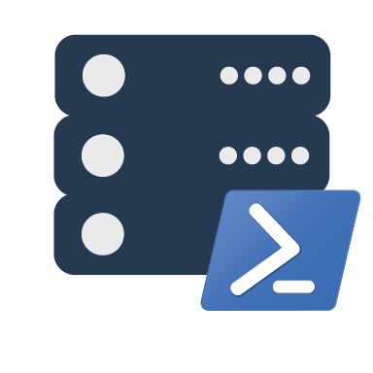
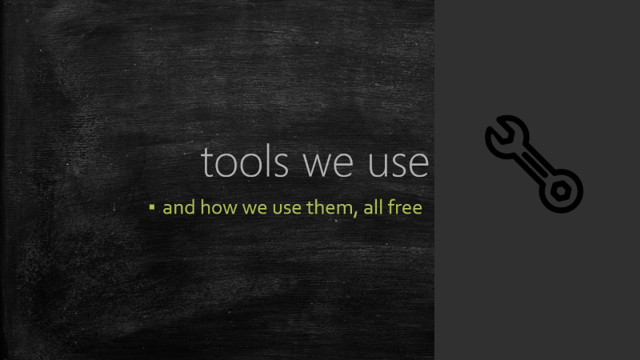
dbatools orientation
the community module
Notes:
Intro to dbatools

Slide 35
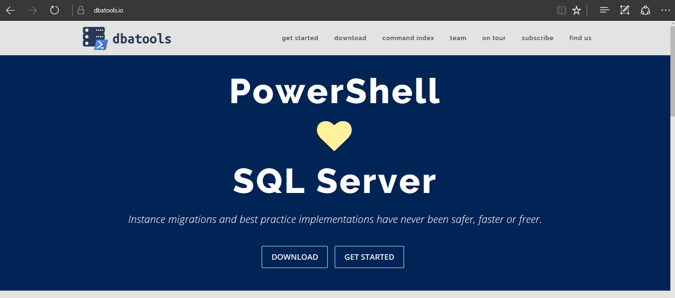
dbatools

Slide 36
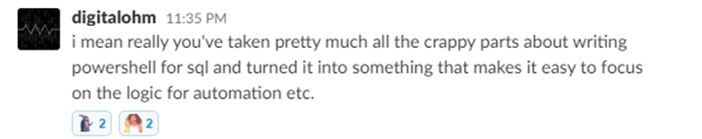
Basically..

Slide 37
Support
SQL Server 2000 – 2017 *
Express – Enterprise Edition
Clustered & stand-alone instances
Windows & SQL authentication
Default & named instances
Multiple instances on one server
Notes:
* Azure

Slide 38
System Requirements
MINIMUM
RECOMMENDED
Client
PowerShell v3
Client
PowerShell v5.1
Notes:
SQL Server 2000 – think “Can SSMS connect?”

Slide 39
System Requirements
MINIMUM
RECOMMENDED
Server
SQL Server 2000
No PowerShell for pure SQL commands
Remoting enabled for Windows commands
Server
SQL Server 2008 R2+
Notes:
SQL Server 2000 – think “Can SSMS connect?”

Slide 40
Install is easy
POWERSHELL GALLERY
Install-Module dbatools
Install-Module dbatools –Scope CurrentUser
POWERSHELL GALLERY - Offline
Save-Module dbatools –Path C:\temp ## Copy to C:\Program Files\WindowsPowerShell\Modules\dbatools

Slide 41

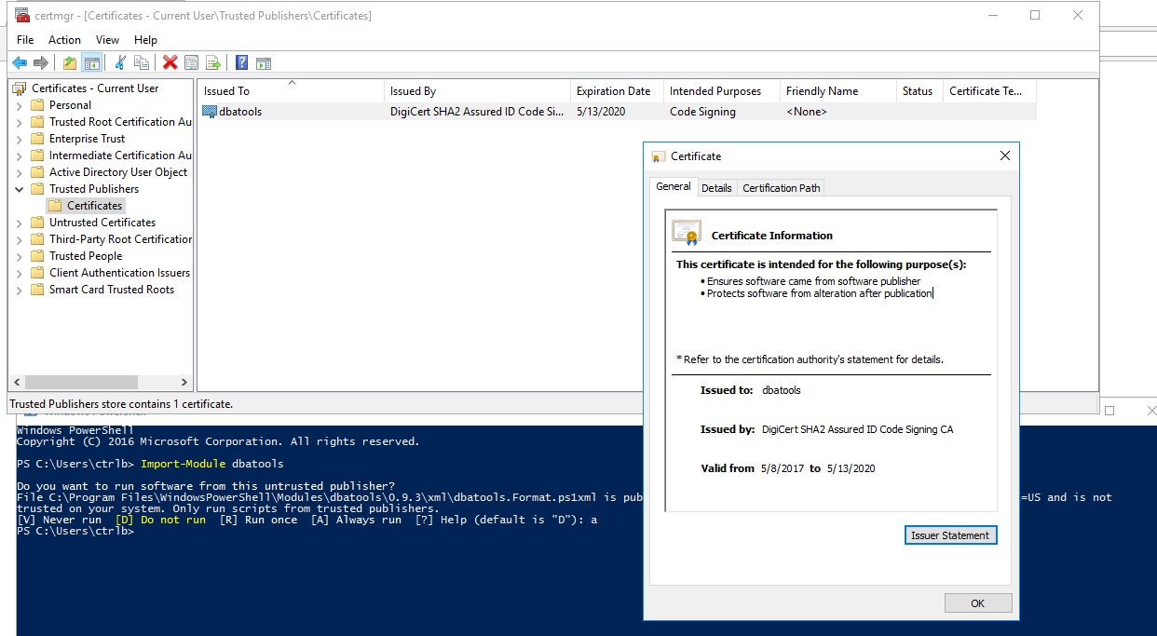
dbatools is digitally signed

Slide 42
For more information
dbatools.io/fullinstall

Slide 43
Find-DbaCommand
How to find a command
Find a command using the tags
Find a command by author
Find-DbaCommand backup
Find-DbaCommand -Tag copy,user
Find-DbaCommand -Author Rob

Slide 44
Get-Help
Extensive documentation within each command
Extensive documentation on dbatools.io
dbatools.io/CommandName
Some commands have videos
dbatools.io/youtube
Get-Help Start-DbaMigration -Detailed

Slide 45
Get-Help
## Here is a neat trick
Find-DbaCommand -Pattern linked | Out-GridView -PassThru | Get-Help -Full

Slide 46
Compare-Object SqlServer dbatools
InputObject | SideIndicator
SqlServer is officially supported by Microsoft | <=
SqlServer is C# cmdlet based | <=
SqlServer is closed-source & must be fixed and enhanced by Microsoft | <=
SqlServer has fewer resources | <=
dbatools has unofficial, community-based support | =>
dbatools is PowerShell function based | =>
dbatools is open source – fix or enhance yourself or ask us | =>
dbatools has 100+ contributors | =>
Notes:
Mention that SqlServer is successor to SQLPS

Slide 47
demo time!
Notes:
# Set some vars
$new = "localhost\sql2016"
$old = $instance = "localhost"
$allservers = $old, $new
# Alternatively, use Registered Servers?
Get-DbaRegisteredServer -SqlInstance $instance | Out-GridView
# Quick overview of commands
Start-Process https://dbatools.io/commands
# You've probably heard about how easy migrations can be with dbatools. Here's an example
$startDbaMigrationSplat = @{
Source = $old
Destination = $new
BackupRestore = $true
NetworkShare = 'C:\temp'
NoSysDbUserObjects = $true
NoCredentials = $true
NoBackupDevices = $true
NoEndPoints = $true
}
Start-DbaMigration @startDbaMigrationSplat -Force | Select * | Out-GridView
# Use Ola Hallengren's backup script? We can restore an *ENTIRE INSTNACE* with just one line
Get-ChildItem -Directory \\workstation\backups\sql2012 | Restore-DbaDatabase -SqlInstance $new
# Nowadays, we don't just backup databases. Now, we're backing up logins
Export-DbaLogin -SqlInstance $instance -Path C:\temp\logins.sql
Invoke-Item C:\temp\logins.sql
# And Agent Jobs
Get-DbaAgentJob -SqlInstance $old | Export-DbaScript -Path C:\temp\jobs.sql
# What if you just want to script out your restore?
Get-ChildItem -Directory \\workstation\backups\subset\ | Restore-DbaDatabase -SqlInstance $new -OutputScriptOnly -WithReplace | Out-File -Filepath c:\temp\restore.sql
Invoke-Item c:\temp\restore.sql
# Complaint: Already have a library of Profiler templates
# Answer: Convert them instantly to Sessions (h/t Jonathan Kehayias)
Get-DbaTrace -SqlInstance sql2014 | ConvertTo-DbaXESession | Start-DbaXESession
# Easily import
Get-DbaXESessionTemplate | Out-GridView -PassThru | Import-DbaXESessionTemplate -SqlInstance $servers | Start-DbaXESession
# Testing your backups is crazy easy!
Start-Process https://dbatools.io/Test-DbaLastBackup
Test-DbaLastBackup -SqlInstance $old | Out-GridView
# But what if you want to test your backups on a different server?
Test-DbaLastBackup -SqlInstance $old -Destination $new | Out-GridView
# Know how snapshots used to be a PITA? Now they're super easy
New-DbaDatabaseSnapshot -SqlInstance $new -Database db1 -Name db1_snapshot
Get-DbaDatabaseSnapshot -SqlInstance $new
Get-DbaProcess -SqlInstance $new -Database db1 | Stop-DbaProcess
Restore-DbaFromDatabaseSnapshot -SqlInstance $new -Database db1 -Snapshot db1_snapshot
Remove-DbaDatabaseSnapshot -SqlInstance $new -Snapshot db1_snapshot # or -Database db1
# We evaluated 37,545 SQL Server stored procedures on 9 servers in 8.67 seconds!
$new | Find-DbaStoredProcedure -Pattern dbatools
# Have an employee who is leaving? Find all of their objects.
$allservers | Find-DbaUserObject -Pattern ad\jdoe | Out-GridView
# Find detached databases, by example
Detach-DbaDatabase -SqlInstance $instance -Database AdventureWorks2012
Find-DbaOrphanedFile -SqlInstance $instance | Out-GridView
# View and change service account
Get-DbaSqlService -ComputerName workstation | Out-GridView
Get-DbaSqlService -ComputerName workstation | Select * | Out-GridView
Get-DbaSqlService -Instance SQL2016 -Type Agent | Update-DbaSqlServiceAccount -Username 'Local system'
# Check out how complete our sp_configure command is
Get-DbaSpConfigure -SqlInstance $new | Out-GridView
Get-DbaSpConfigure -SqlInstance $new -ConfigName XPCmdShellEnabled
# Easily update configuration values
Set-DbaSpConfigure -SqlInstance $new -ConfigName XPCmdShellEnabled -Value $true
# XEs Read and watch
Get-DbaXESession -SqlInstance $new -Session system_health | Read-DbaXEFile
# Reset-DbaAdmin
Reset-DbaAdmin -SqlInstance $instance -Login sqladmin -Verbose
Get-DbaDatabase -SqlInstance $instance -SqlCredential (Get-Credential sqladmin)
# sp_whoisactive
Install-DbaWhoIsActive -SqlInstance $instance -Database master
Invoke-DbaWhoIsActive -SqlInstance $instance -ShowOwnSpid -ShowSystemSpids
# Diagnostic query!
$instance | Invoke-DbaDiagnosticQuery -UseSelectionHelper | Export-DbaDiagnosticQuery -Path $home
Invoke-Item $home
# Ola, yall
$instance | Install-DbaMaintenanceSolution -ReplaceExisting -BackupLocation C:\temp -InstallJobs
# Get db space AND write it to table
Get-DbaDatabaseFile -SqlInstance $instance | Out-GridView
Get-DbaDatabaseFile -SqlInstance $instance -IncludeSystemDB | Write-DbaDataTable -SqlInstance $instance -Database tempdb -Table DiskSpaceExample -AutoCreateTable
Invoke-DbaSqlcmd -ServerInstance $instance -Database tempdb -Query 'SELECT * FROM dbo.DiskSpaceExample' | Out-GridView
# History
Get-Command -Module dbatools *history*
# More histories
Get-DbaAgentJobHistory -SqlInstance $instance | Out-GridView
Get-DbaBackupHistory -SqlInstance $new | Out-GridView
# Test/Set SQL max memory
$allservers | Get-DbaMaxMemory
$allservers | Test-DbaMaxMemory | Format-Table
$allservers | Test-DbaMaxMemory | Where-Object { $_.SqlMaxMB -gt $_.TotalMB } | Set-DbaMaxMemory -WhatIf
Set-DbaMaxMemory -SqlInstance $instance -MaxMb 1023
# Reads trace files - default trace by default
Read-DbaTraceFile -SqlInstance $instance | Out-GridView
# don't have remoting access? Explore the filesystem. Uses master.sys.xp_dirtree
Get-DbaFile -SqlInstance $instance
Get-DbaFile -SqlInstance $instance -Depth 3 -Path 'C:\Program Files\Microsoft SQL Server' | Out-GridView
New-DbaSqlDirectory -SqlInstance $instance -Path 'C:\Program Files\Microsoft SQL Server\MSSQL14.MSSQLSERVER\test'
# Out-GridView madness <3
Get-DbaDatabase -SqlInstance $old | Out-GridView -PassThru | Copy-DbaDatabase -Destination $new -BackupRestore -NetworkShare \\workstation\c$\temp -Force
# We've even got our own config system!
Get-DbaConfig | Out-GridView
# Check out our logs directory, so Enterprise :D
Invoke-Item (Get-DbaConfig -FullName path.dbatoolslogpath).Value
# Want to see what's in our logs?
Get-DbatoolsLog | Out-GridView
# Need to send us diagnostic information? Use this support package generator
New-DbatoolsSupportPackage

Slide 48

SQL Server
Pester
❤️

Slide 49
TODAY’s TO DO LIST
GET UP
Drink Appropriate Liquid
The Rest

Slide 50
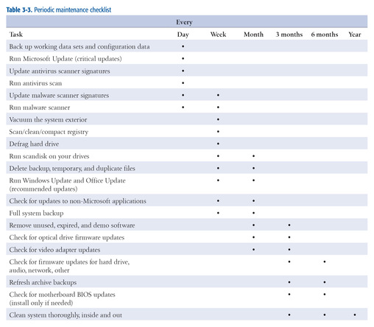
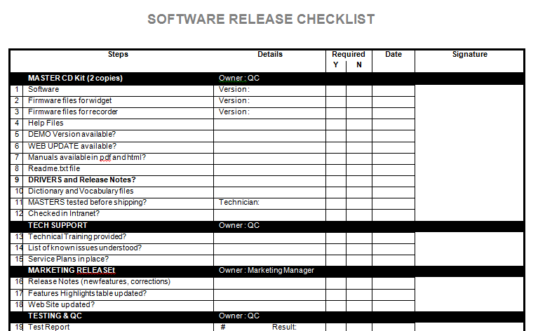
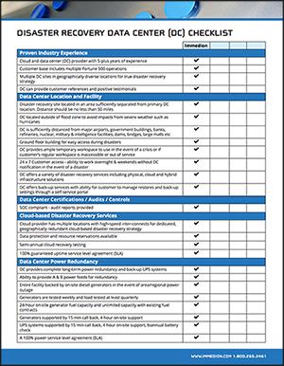
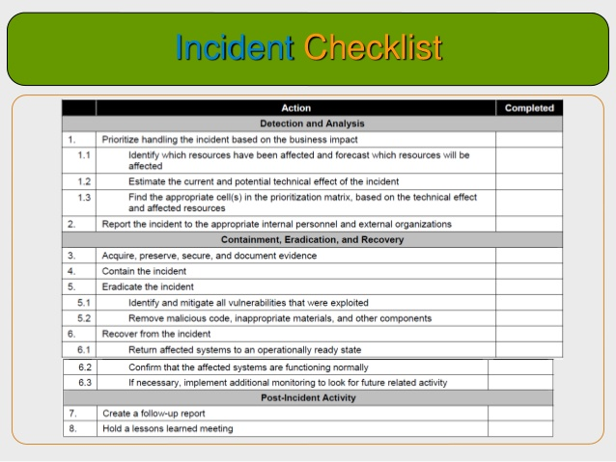
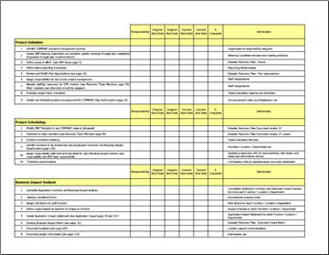
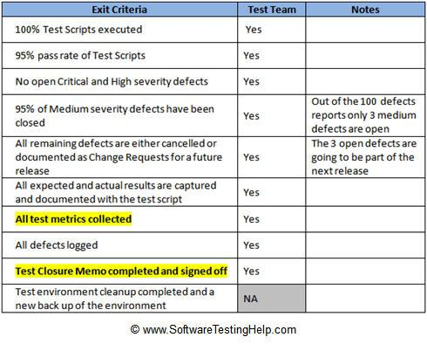
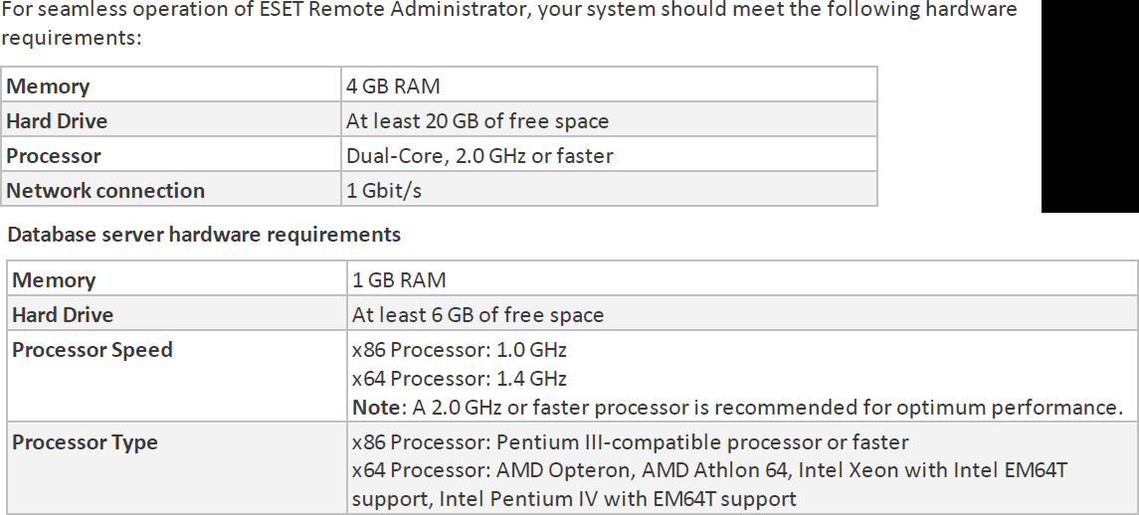
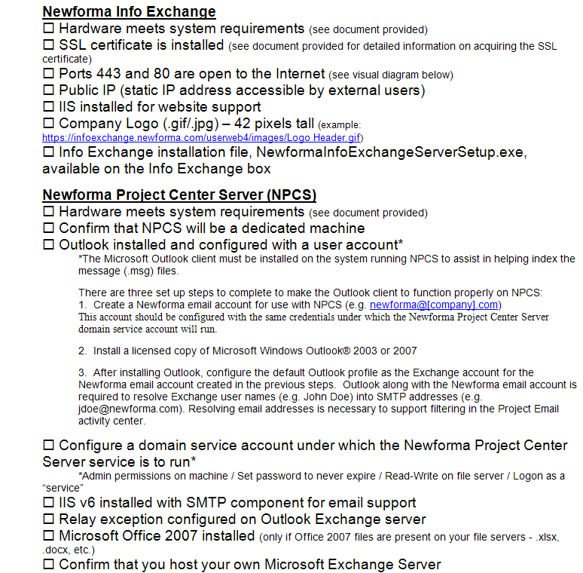
How many checklists do you have?
Notes:
I bet there are checklists for
New servers/ data centers
Hardware/software installations
Incident Response
1st Line/2nd line for systems
Pre-requisites
Morning routines

Slide 51
What about
Demos
Presentations
Morning Checks
Incident Response
First Line Support
I‘m sure you are already thinking of more

Slide 52
What is Pester?
Pester provides a framework for running unit tests to execute and validate PowerShell commands from within PowerShell
sqlps.io/pester
Notes:
Its used for unit testing or TDD but can also be used to validate an environment.
Comes with Windows 10 or install from the gallery with Install-Module Pester

Slide 53
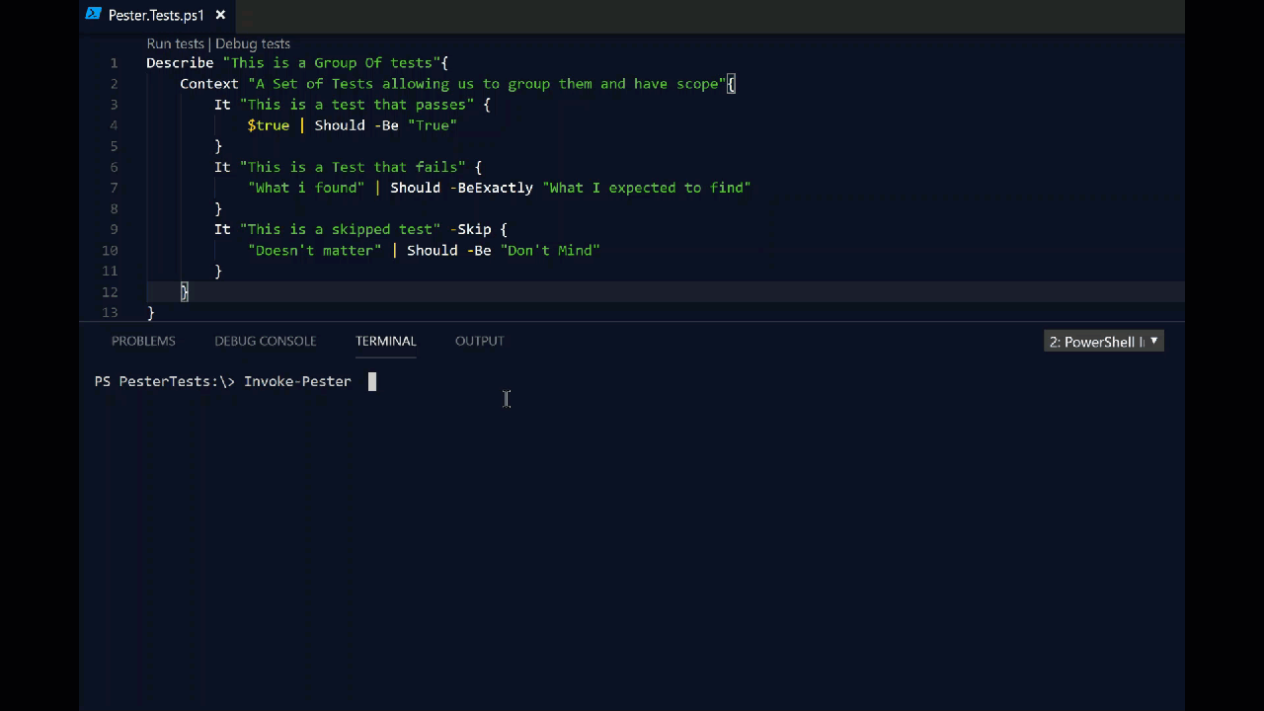
What Does Pester Look Like?
Notes:
This is a Pester test running in VS Code

Slide 54

Apologies. Forgive Me!

Slide 55
Should Operators – Part 1
-Be Compares one object with another for equality. Case Insensitive -BeExactly Compares one object with another for equality. Case Sensitive -BeGreaterThan Asserts that a number is greater than an expected value. -BeLessThan Asserts that a number is less than an expected value.
-BeIn Asserts that the actual value is contained by the array/collection -BeLike Matches a wildcard pattern using -like operator. Case Insensitive -BeLikeExactly Matches a wildcard pattern using -like operator. Case Sensitive -BeOfType Asserts that the actual value should be an object of a specified type -Exist Checks if the object calling Exist is present in a PS Provider. -FileContentMatch Checks to see if a file contains the specified text. Case Insensitive
-FileContentMatchExactly Checks to see if a file contains the specified text. Case Sensitive -ContainExactly Checks to see if a file contains the specified text. Case Sensitive -Match Uses a regular expression to compare two objects. Case Insensitive -MatchExactly Uses a regular expression to compare two objects. Case Sensitive -Throw Checks if an exception was thrown in the input ScriptBlock. -BeNullOrEmpty Checks values for null or empty (strings).
I hate slides with lots of text but I think this one is valid
Notes:
For you to use in the future – The important one to remember is the contains

Slide 56
Should Operators – Part 2
-Be Compares one object with another for equality. Case Insensitive -BeExactly Compares one object with another for equality. Case Sensitive -BeGreaterThan Asserts that a number is greater than an expected value. -BeLessThan Asserts that a number is less than an expected value.
-BeIn Asserts that the actual value is contained by the array/collection -BeLike Matches a wildcard pattern using -like operator. Case Insensitive -BeLikeExactly Matches a wildcard pattern using -like operator. Case Sensitive -BeOfType Asserts that the actual value should be an object of a specified type -Exist Checks if the object calling Exist is present in a PS Provider. -FileContentMatch Checks to see if a file contains the specified text. Case Insensitive
-FileContentMatchExactly Checks to see if a file contains the specified text. Case Sensitive -ContainExactly Checks to see if a file contains the specified text. Case Sensitive -Match Uses a regular expression to compare two objects. Case Insensitive -MatchExactly Uses a regular expression to compare two objects. Case Sensitive -Throw Checks if an exception was thrown in the input ScriptBlock. -BeNullOrEmpty Checks values for null or empty (strings).
I hate slides with lots of text but I think this one is valid
Notes:
For you to use in the future – The important one to remember is the contains

Slide 57
Should Operators – Part 2
Not -Be Compares one object with another for equality. Case Insensitive Not -BeExactly Compares one object with another for equality. Case Sensitive Not -BeGreaterThan Asserts that a number is greater than an expected value. Not -BeLessThan Asserts that a number is less than an expected value.
Not -BeIn Asserts that the actual value is contained by the array/collection Not -BeLike Matches a wildcard pattern using -like operator. Case Insensitive Not -BeLikeExactly Matches a wildcard pattern using -like operator. Case Sensitive Not -BeOfType Asserts that the actual value should be an object of a specified type Not -Exist Checks if the object calling Exist is present in a PS Provider. Not -FileContentMatch Checks to see if a file contains the specified text. Case Insensitive
Not -FileContentMatchExactly Checks to see if a file contains the specified text. Case Sensitive Not -ContainExactly Checks to see if a file contains the specified text. Case Sensitive Not -Match Uses a regular expression to compare two objects. Case Insensitive Not -MatchExactly Uses a regular expression to compare two objects. Case Sensitive Not -Throw Checks if an exception was thrown in the input ScriptBlock. Not -BeNullOrEmpty Checks values for null or empty (strings).
Every Should can be Should Not
I hate slides with lots of text but I think this one is valid
Notes:
For you to use in the future – The important one to remember is the contains

Slide 58
Get-Help Writing Pester Tests
Decide the information you wish to test
Understand how to get it with PowerShell
Understand what makes it pass or fail
Write the test

Slide 59
Hey Beardy!
DEMO
Time

Slide 60
Summary
We all have checklists – manual testing is error-prone
Pester is a Unit Testing Framework for PowerShell
You can use it to validate your infrastructure
The basic syntax - Describe, Context and It code blocks
The Should command is used for testing assertions
Use the NunitXML output, export to JSON and use PowerBi for fantastic reports or to be consumed in your CI/CD process

Slide 61

Lunch

Slide 62
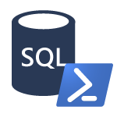
PowerShell & SQL Agent
PowerShell Job Step
CmdExec Job Step
sqlps.exe
Version varies by SQL version
Doesn’t always work as expected
powershell.exe via cmd.exe
Version is always the system version
Often (always?) works as expected

Slide 63
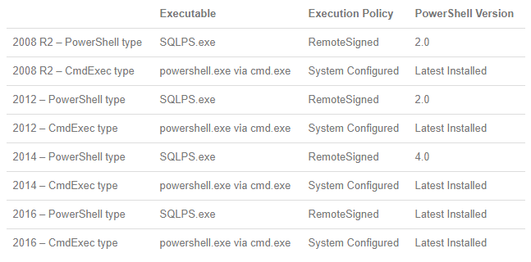
PowerShell & the SQL Server Agent
Thanks to Derik Hammer for this chart!
Notes:
https://www.sqlhammer.com/running-powershell-in-a-sql-agent-job/

Slide 64
PowerShell & the SQL Server Agent
Create a Windows-based Login in SQL Server
Ensure dbatools is available to the account
Create a SQL Server credential
Create the Agent Proxy
Create the PowerShell .ps1 file
Create the Job and Job Step
Schedule the Job
dbatools.io/agent

Slide 65
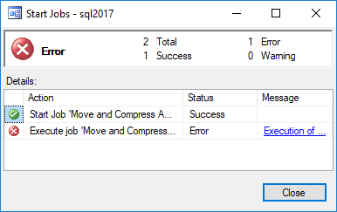
Ensure failed jobs fail
To ensure a job fails, throw a terminating exception
In dbatools, use –EnableException
In most PowerShell commands, use try/catch with –ErrorAction Stop

Slide 66
Pester for DBA’s – Quick Recap
Validation that our estate is as we expect it to be
PowerShell over T-SQL as it is easier to access
Multiple Instances
Active Directory
File System
Registry
Many more things easier!
Notes:
Pester enables validation that our Instances are as we expect them to be
The beauty of using PowerShell over T-SQL is that PowerShell can easily access more properties from other providers – Azure, Active Directory, File System, DNS, Registry etc

Slide 67
Pester for Developers
“Even though we are Operations, because we are writing scripts that others will use, we are now developers as well. We need to understand that TDD is a better way of writing good quality code and enabling us to follow good practices”
Some Bearded Fellow throughout 2017

Slide 68



Pester for Audits & Regulations
DISA STIG
GDPR
CIS
Notes:
Defense Information Systems Agency
Security Technical Implementation Guides
EU General Data Protection Regulation
Center for Internet Security
Pester can also be used for simplifying audits such as those required by DISA, CIS and GDPR. Imagine as a DBA, having 50 servers with 1000 databases. And each of these servers may be subject to up to 300 checks each. That's nearly 300,000 checks total! Recently, I went through an audit and initially, kept track of each pass/fail manually. I'd check my servers with PowerShell, then write down each of the failures that had to be documented or remediated.
It was exhausting.
But after I thought about it, I realized that Pester would be perfect to not only keep track of these checks for my immediate needs, but on an ongoing basis as well. So in this way, using Pester can keep you more secure by helping to ensure long-term compliance.
Not only that, it looks super impressive! I was so exciting seeing all this green fly by, that I showed my boss, the IA team and even the auditors. And while the auditors did not accept the results without manual checks, they were chuffed that a random DBA had this cool tool to help ensure compliance. So basically, you can impress your friends, your boss, auditors and even executive management - all with Pester (and you can even add in a sprinkle of PowerBI to make the results clickable and beautiful).

Slide 69

Introducing dbachecks
the new community module

Slide 70
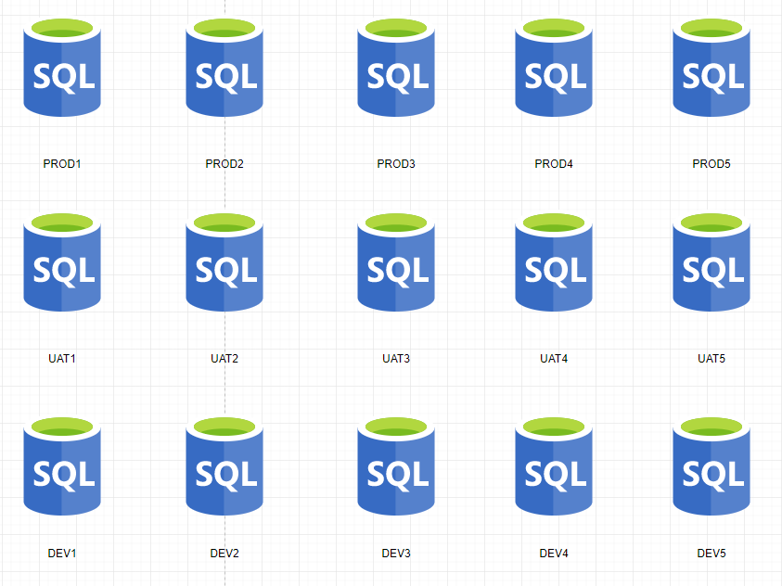
Main Challenge - Configuration
We wanted to be able to check a SQL environment like Production, UAT, DEV – horizontal
We wanted to be able to check all the SQL Environments for a whole application – vertical
We wanted to be able to check the SQL estate for a solution or system – block

Slide 71
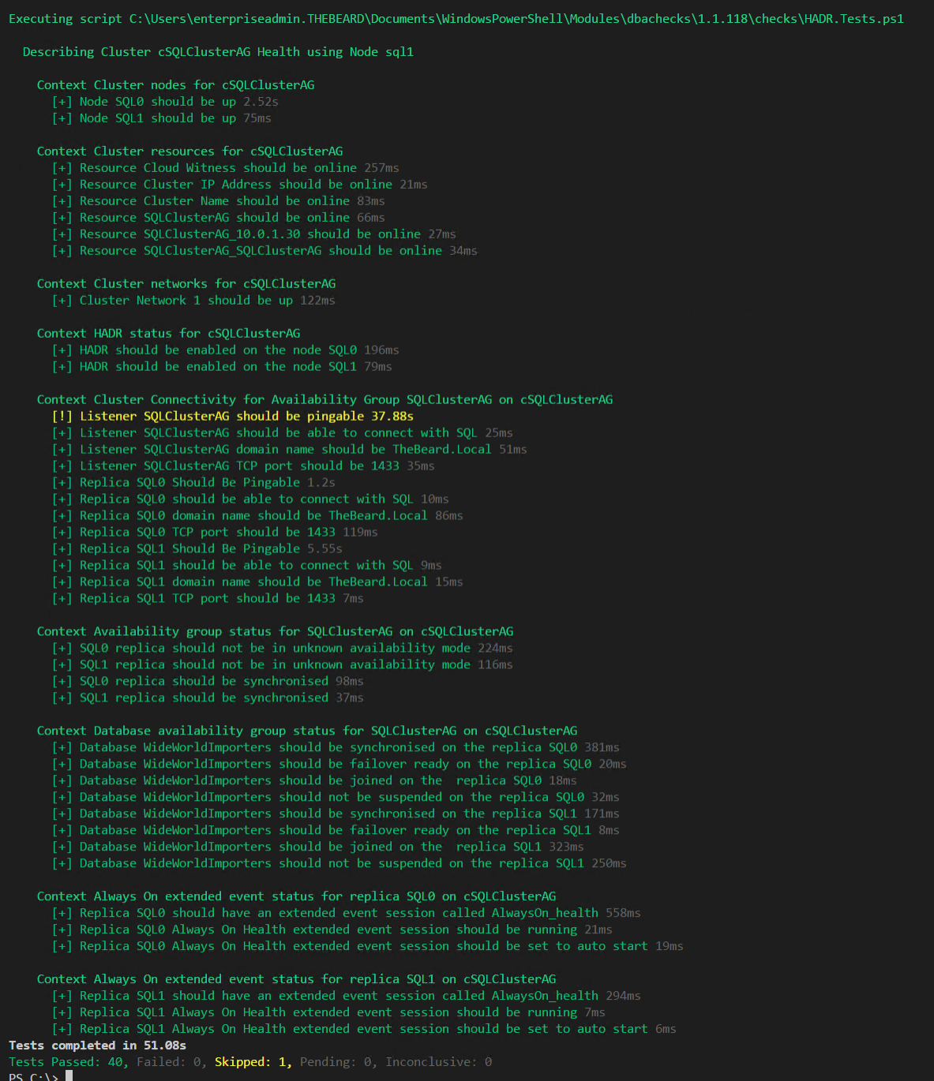
Challenge - Output
DBAs may need output instantly

Slide 72
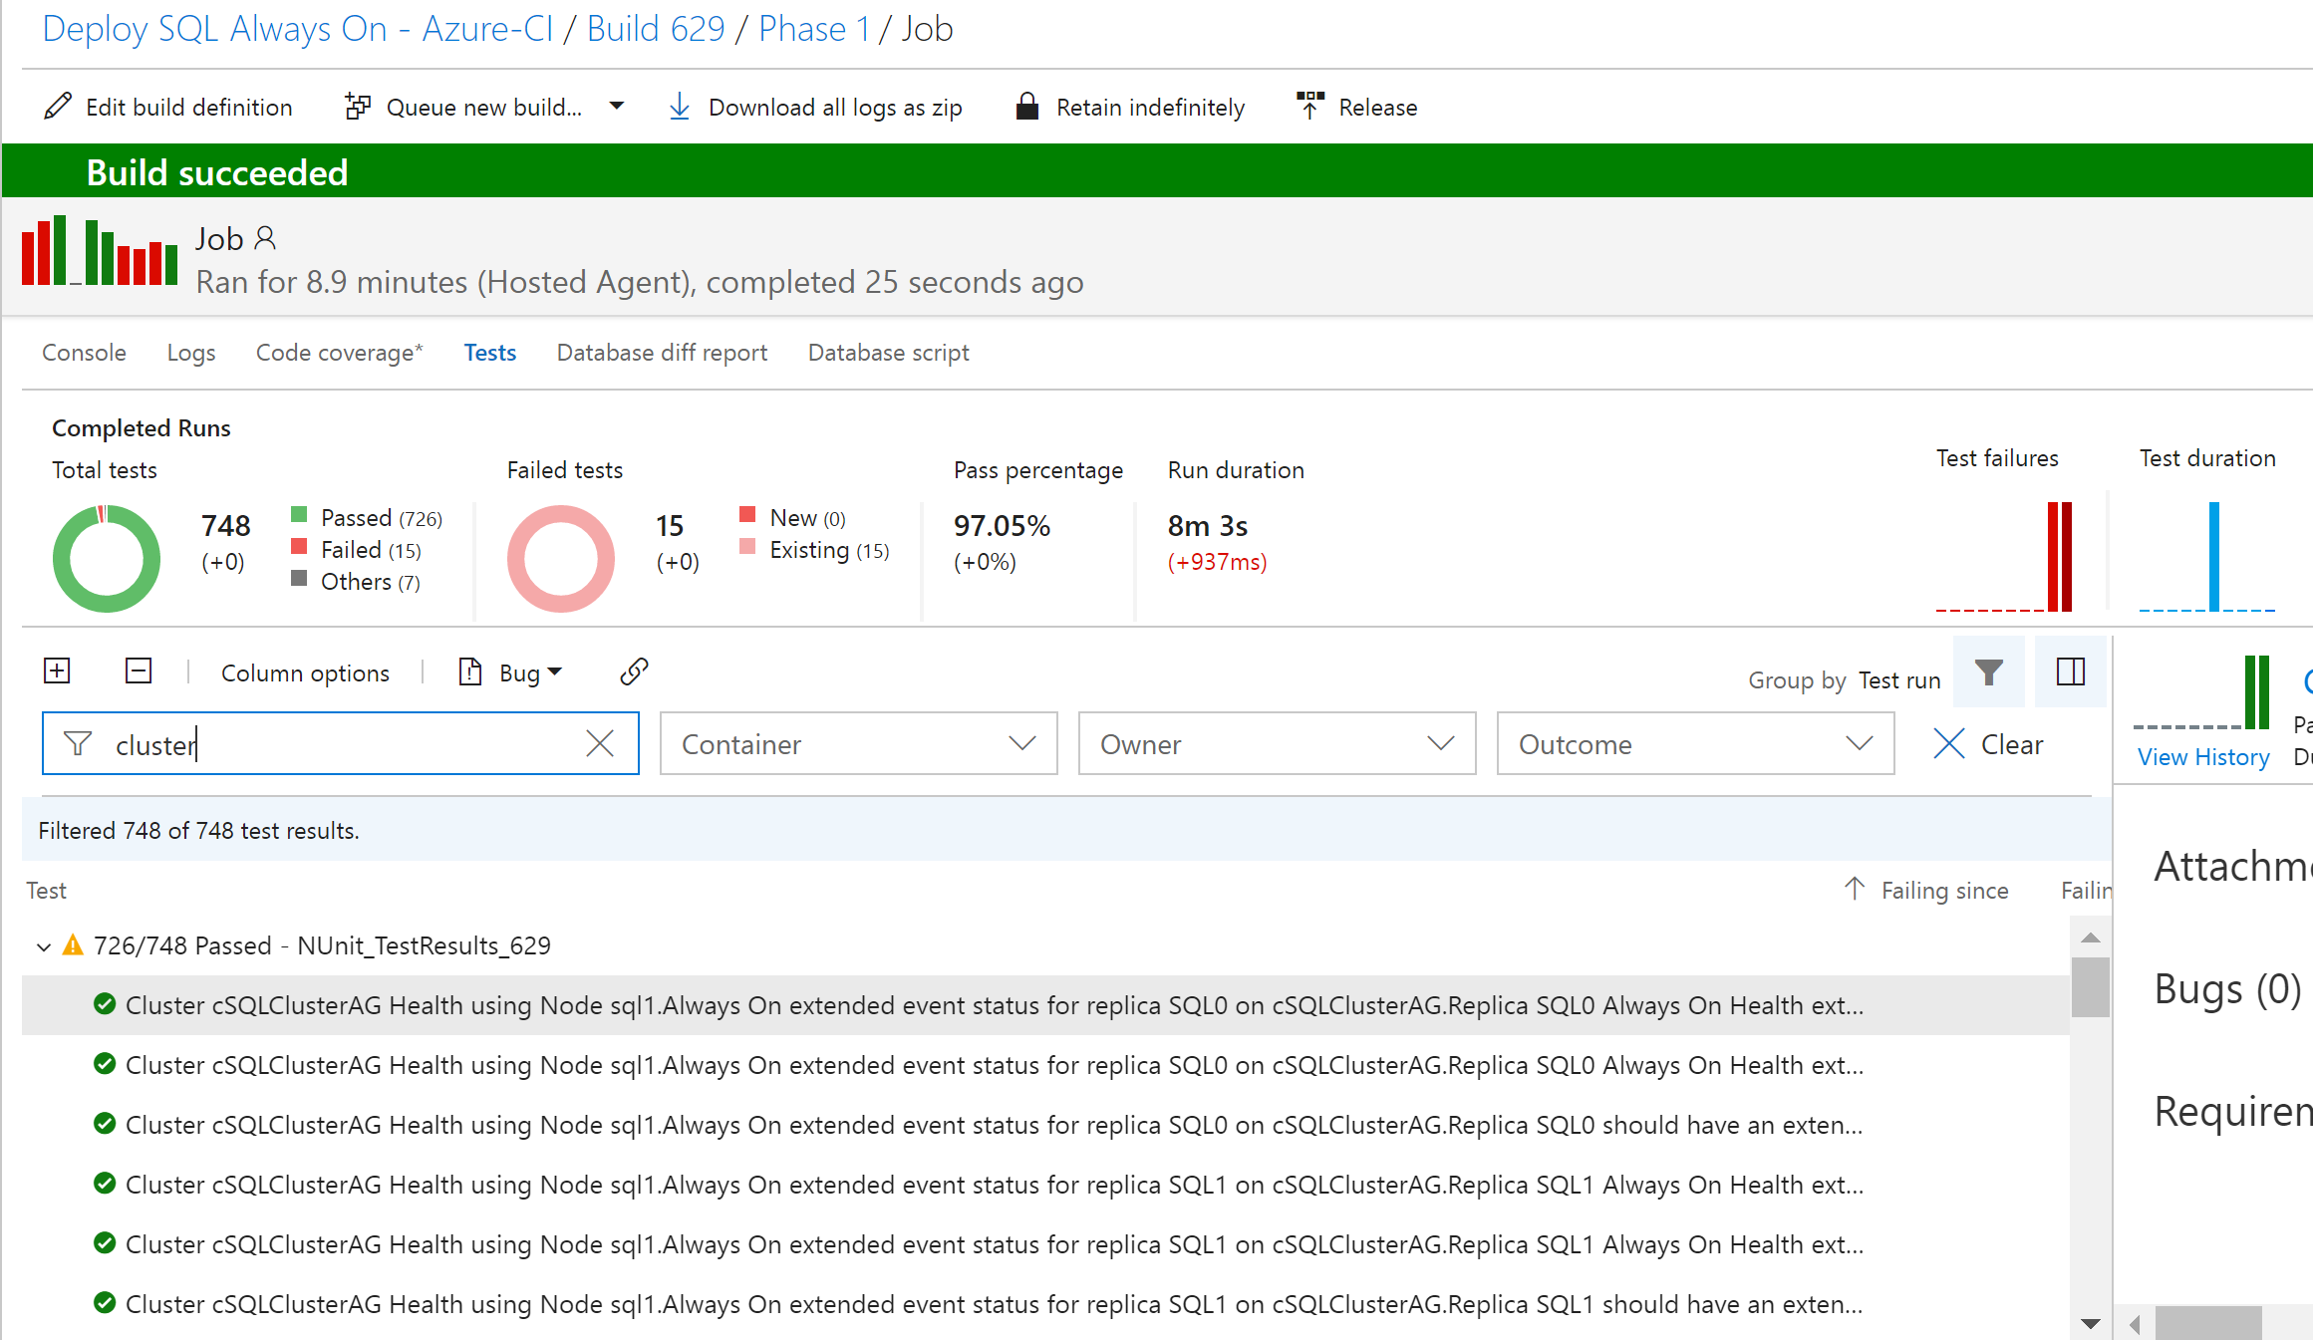
Challenge - Output
DBAs may want to automate and integrate with other solutions (DevOps, Daily Checks, Incident Response, Maintenance Windows)

Slide 73
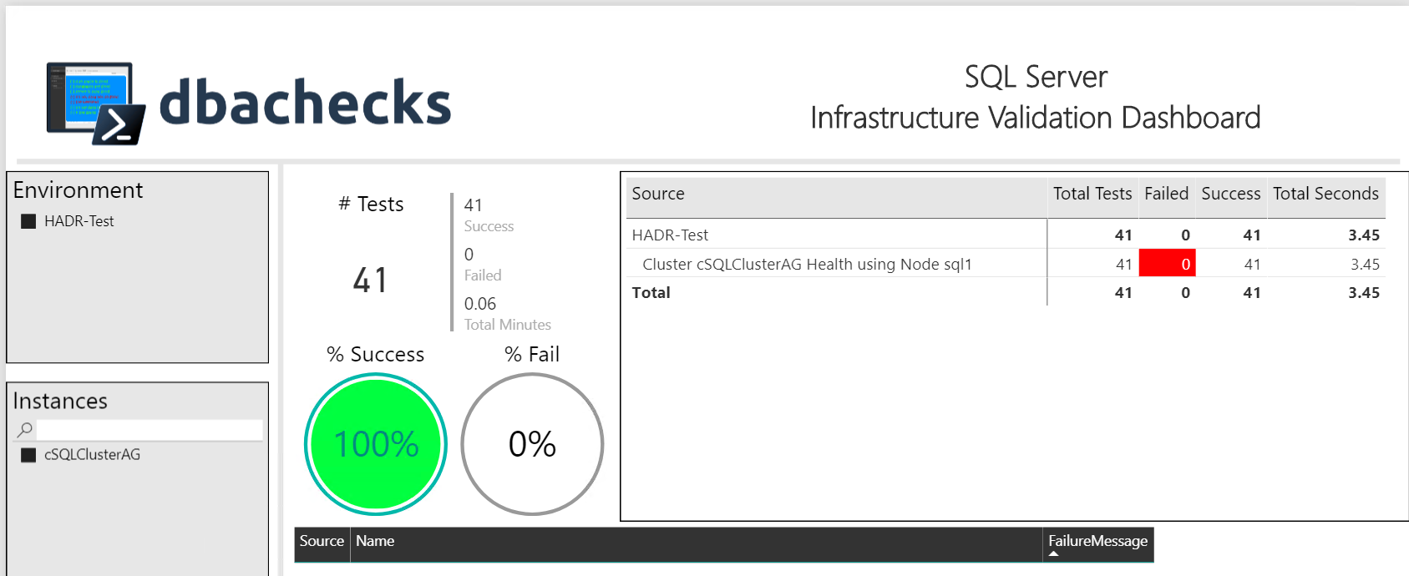
Challenge - Output
Management want output they understand
– (and with pretty interactive pictures !)

Slide 74
Our Goal
Create redistributable, easily configurable Pester tests using industry leaders checklists
Enable output to suit the requirements of different types of end users human and machine
Capability to provide response/resolution ?

Slide 75
System Requirements
Minimum
Recommended
Client
PowerShell v4
Modules
dbatools
Pester
PSFramework
Client
PowerShell v5.1
Server
Everything dbatools supports
From SQL2000 to SQL vNext

Slide 76
Install is easy
PowerShell Gallery
Install-Module dbachecks
Install-Module dbachecks –Scope CurrentUser
* Automatically installs required modules

Slide 77
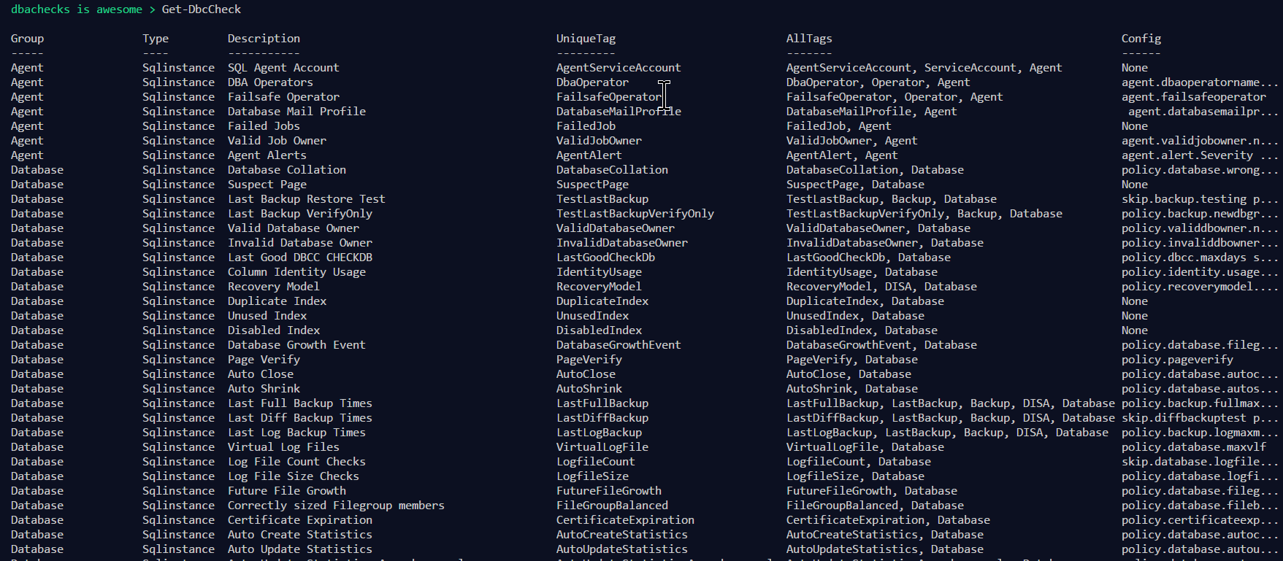
Get-DbcCheck - What Checks Are Available?

Slide 78
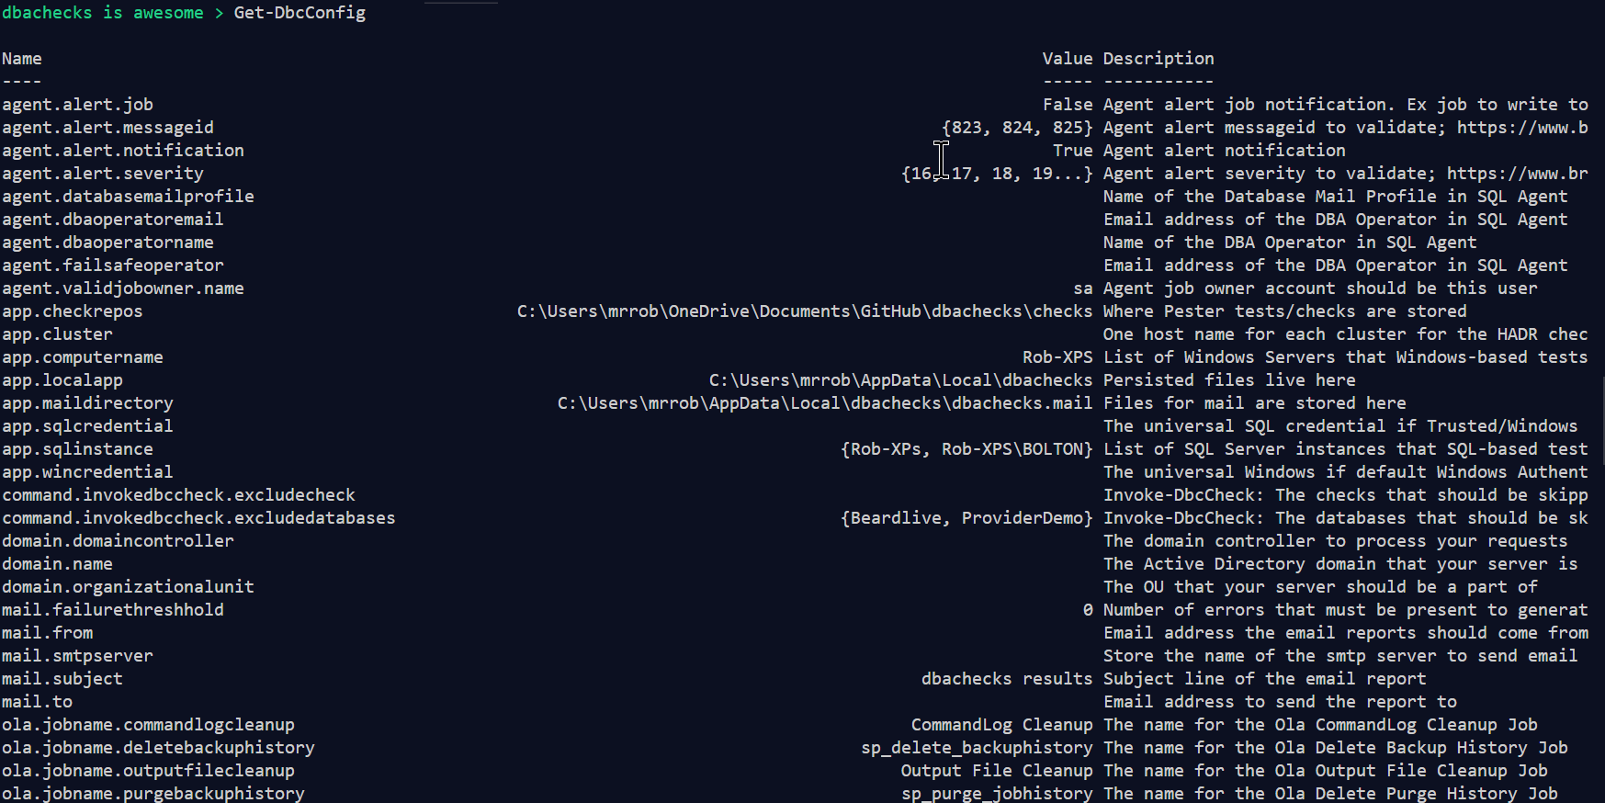
Get-DbcConfig - What Configs Are Available?

Slide 79
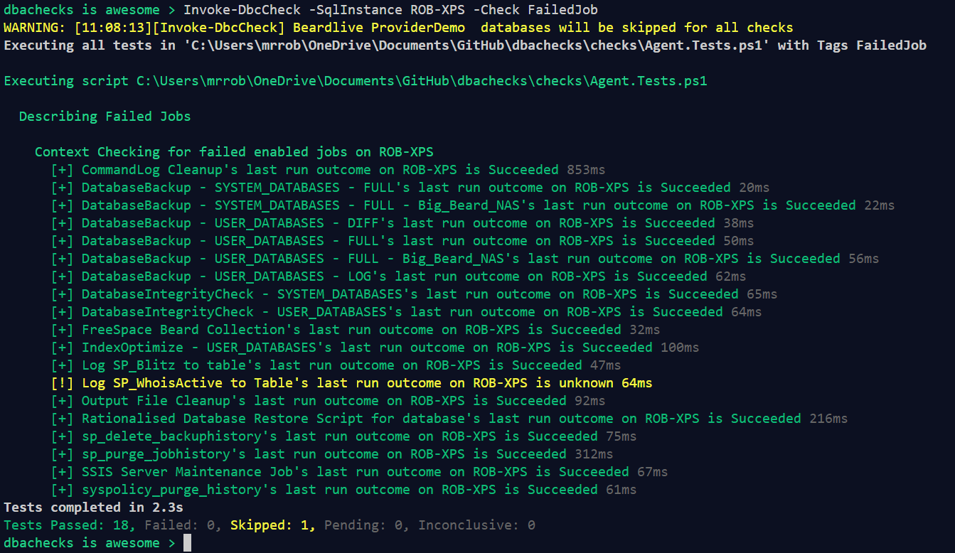
Invoke-DbcCheck – Run A Check

Slide 80
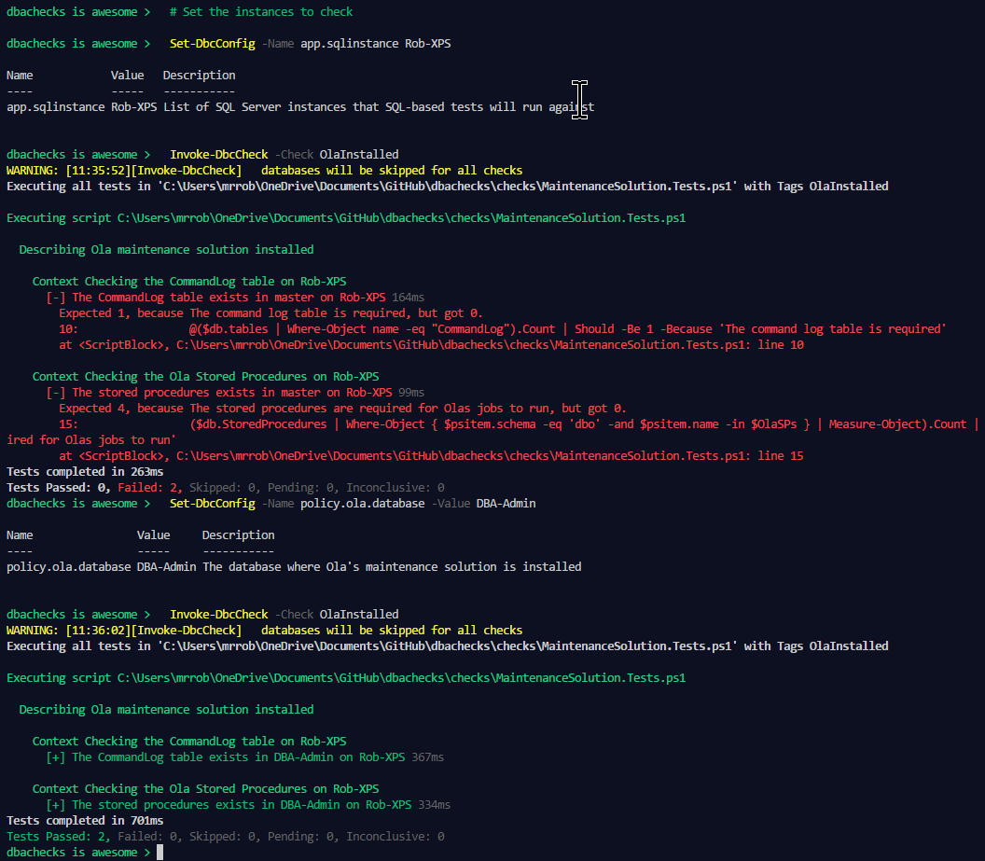
Set-DbcConfig – Config a Check
> # Set the instances to check
> Set-DbcConfig -Name app.sqlinstance Rob-XPS
> Invoke-DbcCheck -Check OlaInstalled
> Set-DbcConfig -Name policy.ola.database -Value DBA-Admin
> Invoke-DbcCheck -Check OlaInstalled

Slide 81
Export-DbcConfig/Import-DbcConfig
Export-DbcConfig –Path C:\Users\Beard\git\PesterConfigs\Application1_PROD.json
Export-DbcConfig -Path C:\Users\Hair\git\PesterConfigs\Client1_System2_Quick.json
Import-DbcConfig -Path Git:\PesterConfigs\Application1_PROD.json
Invoke-DbcCheck
Import-DbcConfig -Path Git:\PesterConfigs\Client1_System2_Quick.json
Invoke-DbcCheck

Slide 82
Start-DbcPowerBi
Import-DbcConfig –path Git:\PesterConfigs\App1_Dev.json
Invoke-DbcCheck -Show Summary -PassThru | Update-DbcPowerBiDataSource –Environment Development
Import-DbcConfig –path Git:\PesterConfigs\App1_Test.json
Invoke-DbcCheck -Show Summary -PassThru | Update-DbcPowerBiDataSource –Environment Test
Import-DbcConfig –path Git:\PesterConfigs\App1_PROD.json
Invoke-DbcCheck -Show Summary -PassThru | Update-DbcPowerBiDataSource –Environment Production
Start-DbcPowerbi

Slide 83
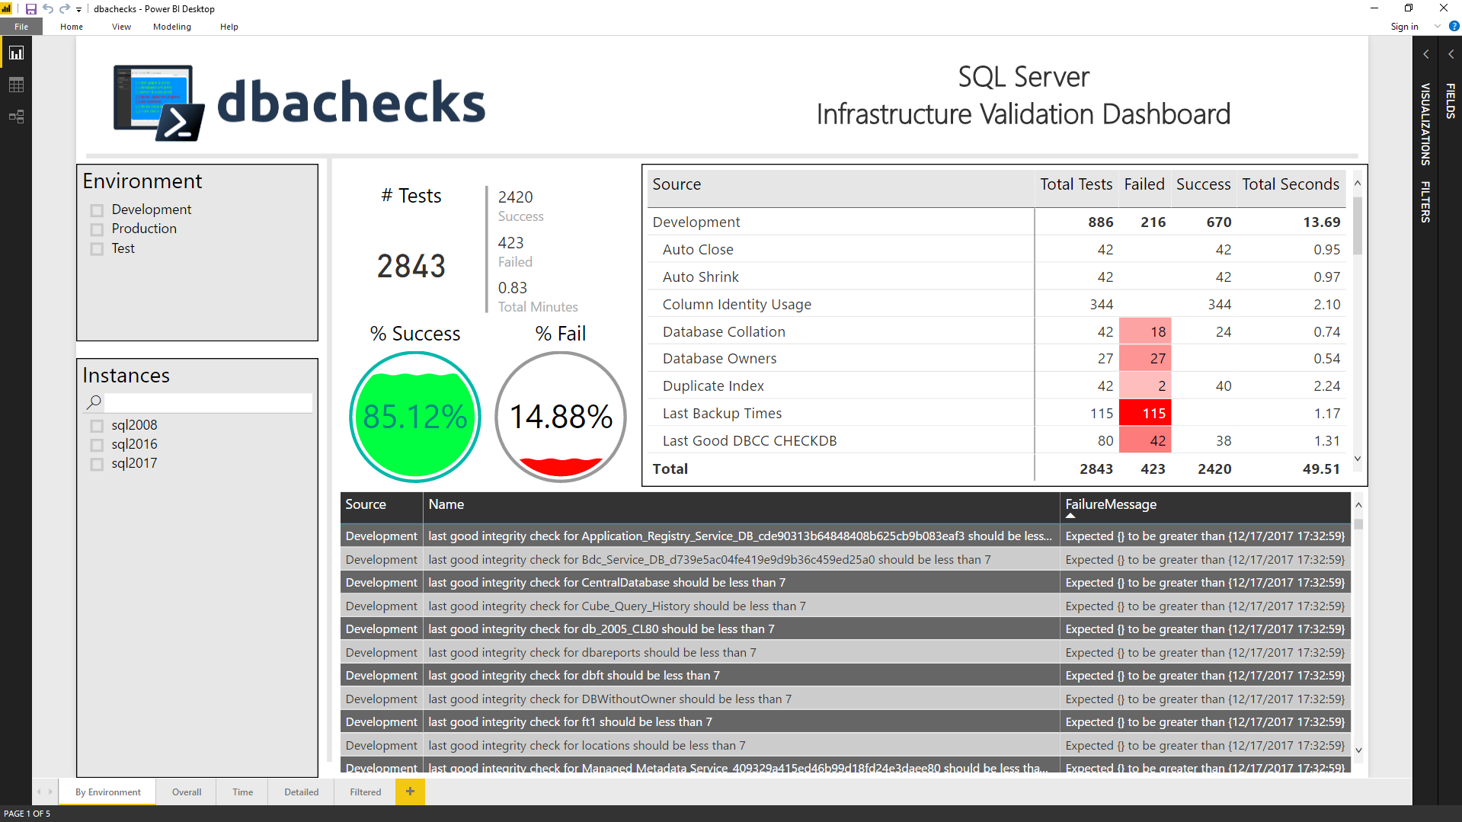
Start-DbcPowerBi

Slide 84
Hey Beardy !
MUST BE TIME FOR A DEMO

Slide 85
Blog posts & Twitter
dbachecks.io/intro
dbachecks.io/deepdive
dbachecks.io/blog
dbachecks.io/twitter

Slide 86

Questions!

Slide 87
Thank you!

Slide 88
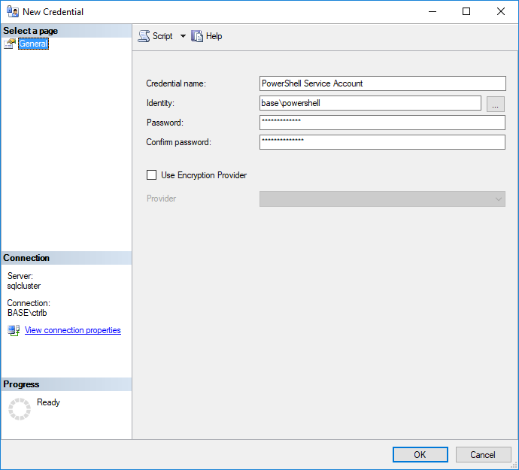
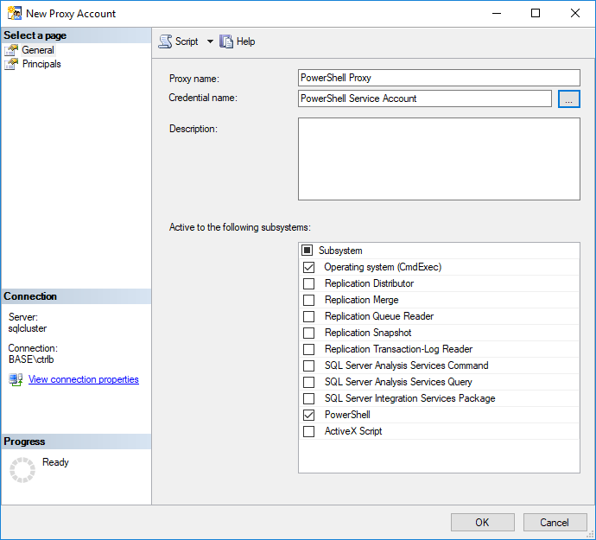
PowerShell & the SQL Server Agent

Slide 89
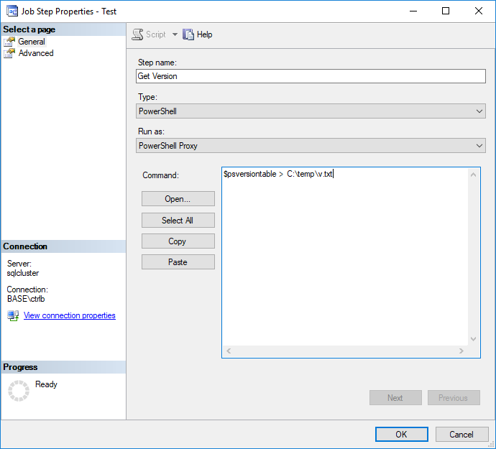
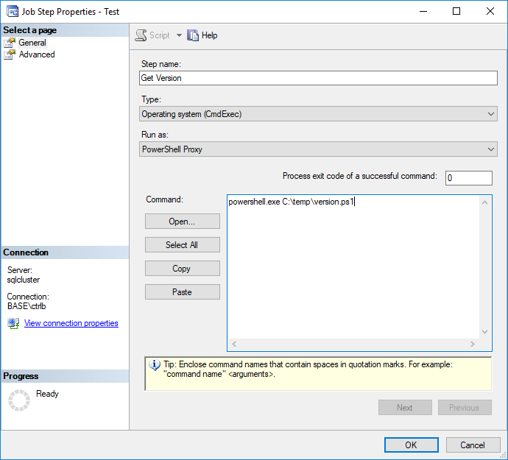
PowerShell & the SQL Server Agent

Slide 90

Join our Slack channel
Invite yourself to Slack
dbatools.io/slack
Join #dbachecks and #dbatools
Ask questions, possibly get answers in real time ;)

Slide 91
Crowdsourced Test Writing

Slide 92

tools we use
and how we use them, all free

Slide 93

VSTS
Visual Studio Team Services

Slide 94
For more information
sqlps.io/vsts

Slide 95

AppVeyor

Slide 96

AppVeyor
Continuous Integration solution for Windows
Often used by PowerShell projects
Fast build VMs with pre-installed software
Free for OSS

Slide 97
AppVeyor is essential to our build process
Starts 4 VMs with pre-installed SQL Server instances
SQL Server 2008 R2
SQL Server 2016
SQL Server 2016 for restart/update commands
SQL Server 2016 + 2008 R2 for migration commands
Ensures standards – help, tab-indented, trailing spaces
dbatools.io/ci and dbatools.io/tests

Slide 98

Power BI

Slide 99

Dashboards galore

Slide 100
Title and Content Layout with List
Add your first bullet point here
Add your second bullet point here
Add your third bullet point here

Slide 101
Title and Content Layout with Chart

Slide 102
Two Content Layout with Table
First bullet point here
Second bullet point here
Third bullet point here
Class | Group A | Group B
Class 1 | 82 | 95
Class 2 | 76 | 88
Class 3 | 84 | 90

Slide 103
Two Content Layout with SmartArt
Group A
Task 1
Task 2
Group B
Task 1
Task 2
Group C
Task 1
First bullet point here
Second bullet point here
Third bullet point here

Slide 104
Add a Slide Title - 1

Slide 105
Add a Slide Title - 2

Slide 106
Add a Slide Title - 3

Slide 108
Add a Slide Title - 4

Slide 109
Add a Slide Title - 5

Slide 110
Title Layout
Subtitle

Slide 111
Orientation

Slide 112
Real-world ownership
sqlps.io/owned
Notes:
See a dude own a DC thru jpg, sql server and a stolen token

Slide 113
Need an offline install?
dbatools.io/offline

Slide 114
Install is easy
POWERSHELL GALLERY
Install-Module dbatools
Install-Module dbatools –Scope CurrentUser
GITHUB
Invoke-Expression (Invoke-WebRequest dbatools.io/in)
WEBSITE
dbatools.io/download

Slide 115
Now, to Import
After installing, you must import the module
Import-Module dbatools
Module manifest vs. Script module
psd1 – module manifest
formal, explicit
psm1
more informal, all functions are imported
Notes:
Speaking of functions!

Slide 116
Set-ExecutionPolicy
“Execution Policy is not a security control and should not be treated as one. The security control is Application Whitelisting (AppLocker / Device Guard)” ~ PowerShell Team
“It's important to understand that the setting was never meant to be a security control. Instead, it was intended to prevent administrators from shooting themselves in the foot.” ~ Scott Sutherland, author of PowerUpSQL
Notes:
https://blog.netspi.com/15-ways-to-bypass-the-powershell-execution-policy
https://www.darkoperator.com/blog/2013/3/5/powershell-basics-execution-policy-part-1.html
https://blogs.msdn.microsoft.com/powershell/2008/09/30/powershells-security-guiding-principles/
“ExecutionPolicy is like a baby door. The ExecutionPolicy keeps babies safe but every grown-up passes it easily.” ~ David das Neves, Microsoft PFE

Slide 117
Writing Pester Tests

Slide 118
Need an offline install?
POWERSHELL GALLERY FROM CONNECTED WORKSTATION
Save-Module dbachecks, dbatools, Pester, PSFramework

Slide 119
Need an offline install?
Save-Module dbachecks, dbatools, Pester, PSFramework

Slide 120
Compare-Object SqlServer, dbatools
SqlServer is officially supported by Microsoft
SqlServer is C# cmdlet based
SqlServer is closed-source & must be fixed and enhanced by Microsoft
SqlServer has fewer resources
dbatools has unofficial, community-based support
dbatools is PowerShell function based
dbatools is open source – fix or enhance yourself or ask us
dbatools has 100+ contributors
Notes:
Mention that SqlServer is successor to SQLPS

